Slide 1
Embedded Systems Lab Project
Bumble Bee
Mariam Jamal
Seenu Manamkeril Mohiyadeen
Soumya Gulapannavar
Violanta Fernandes

Slide 2
Weekly Goals
Week 1 : Get sensors working and drawing calibration charts
Week 2 : Construction of robot using Legos and get the motors working
Week 3 : Avoiding obstacles
Week 4 : Detection of target and Construction of robot
Week 5 : Optimizing code and preparing presentation

Slide 3
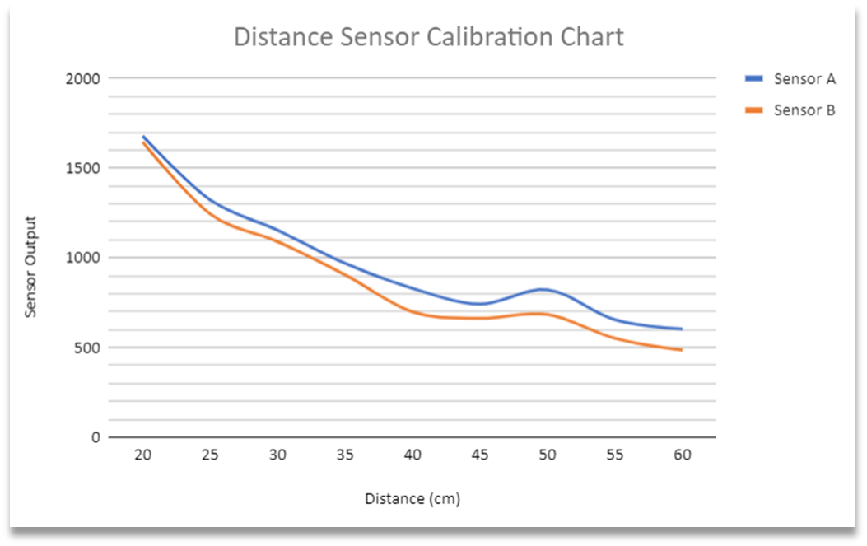
Sensor Calibration

Slide 4
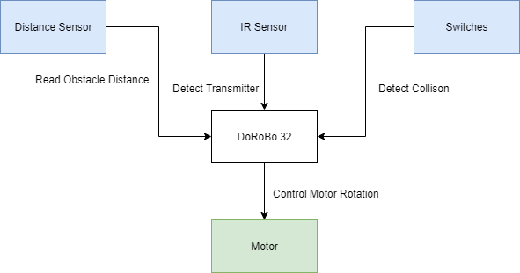
Block Diagram

Slide 5

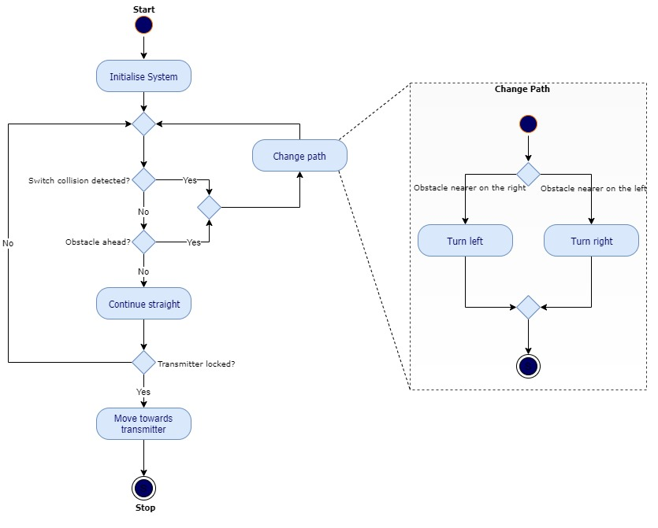
Activity Diagram

Slide 6
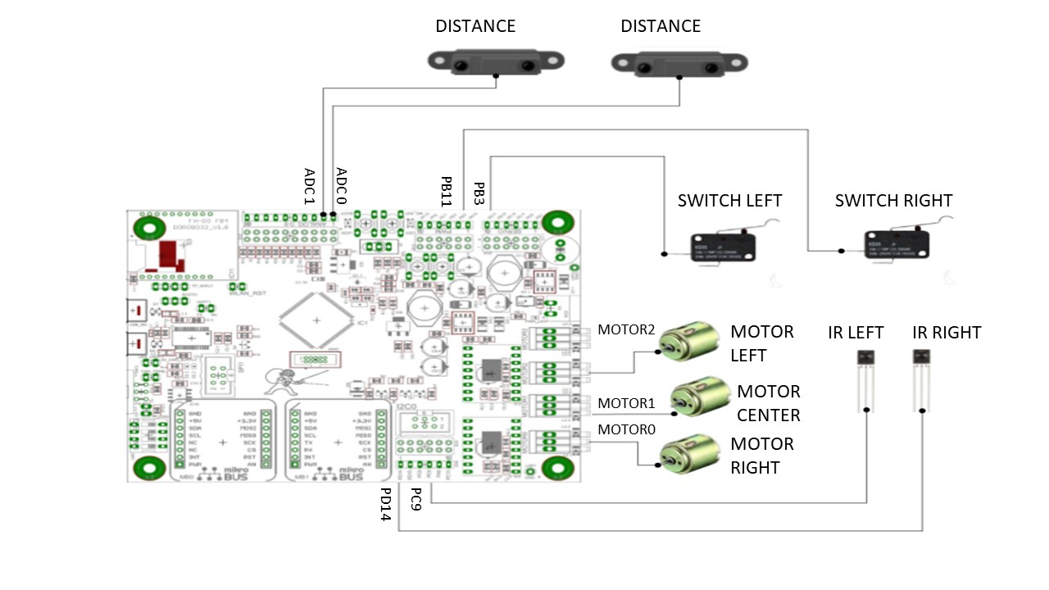
Circuit Diagram

Slide 7
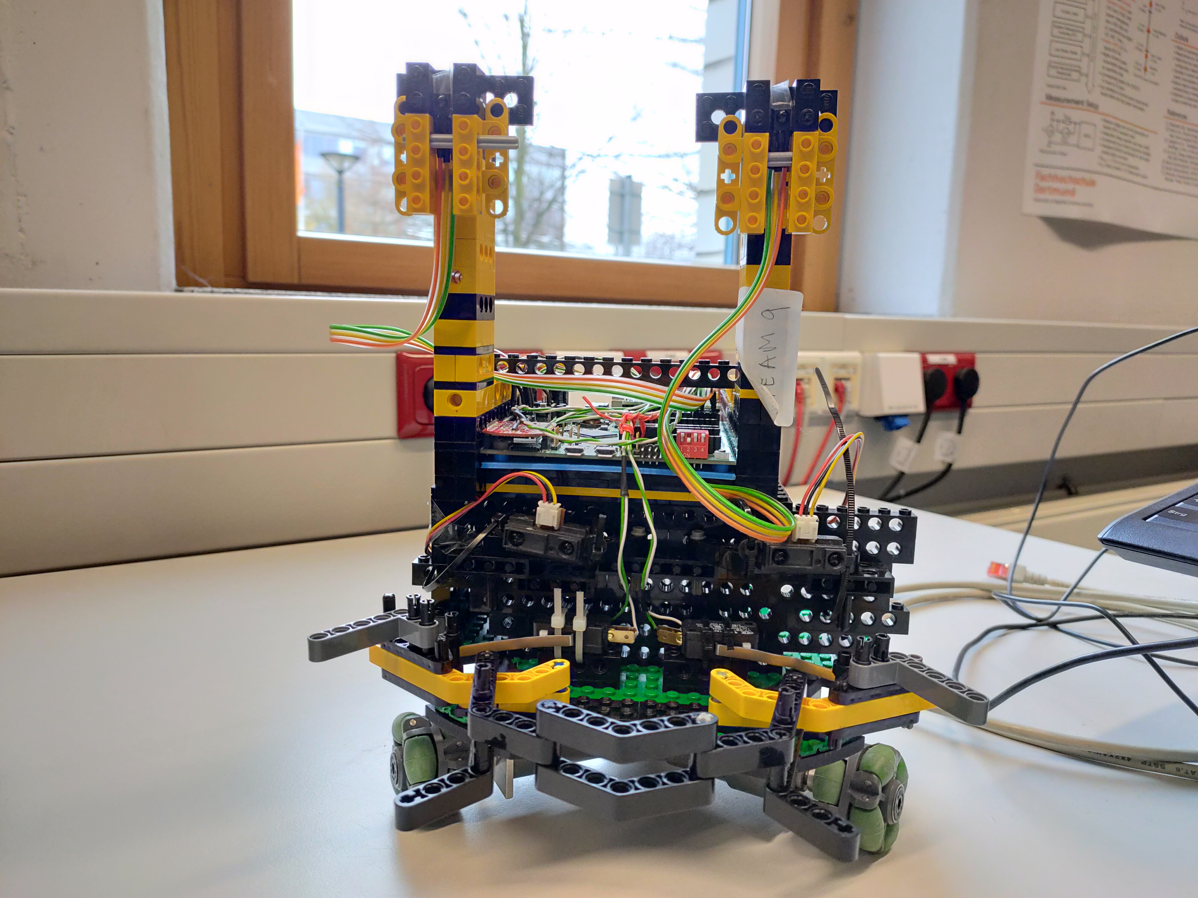

Slide 8
Thank You

